Slide 1
Computer Vision Colour space

Slide 2
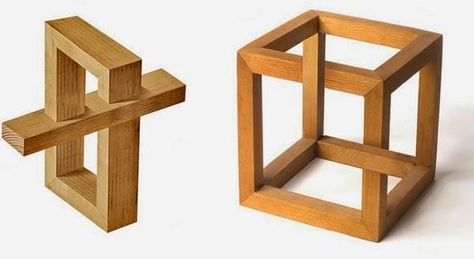
We don’t really understand vision
Visual cortex - highly studied part of the brain
Only rough idea of what different components do
New discoveries in vision all the time
Eye uses blinking to reset its rotational orientation
Visual cortex can make some “high-level” decisions

Slide 3
Is vision easy or hard for humans?
What do you think?

Slide 4


Is vision easy or hard for humans?
What do you think now?

Slide 5
Image Formation

Slide 6
Objectives
Fundamental imaging notions
Physical basis for image formation
Light
Color
Perception
Synthetic camera model
Other models

Slide 7
Image Formation
In computer graphics, we form images which are generally two dimensional using a process analogous to how images are formed by physical imaging systems
Cameras
Microscopes
Telescopes
Human visual system

Slide 8
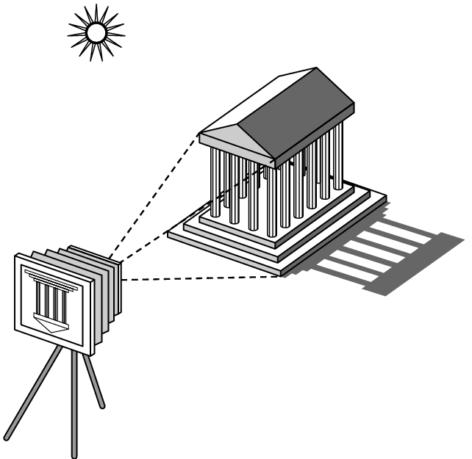
Elements of Image Formation
Objects
Viewer
Light source(s)
Attributes that govern how light interacts with the materials in the scene
Note the independence of the objects, the viewer, and the light source(s)

Slide 9
Light
Light is the part of the electromagnetic spectrum that causes a reaction in our visual systems
Generally these are wavelengths in the range of about 350-750 nm (nanometers)
Long wavelengths appear as reds and short wavelengths as blues

Slide 10
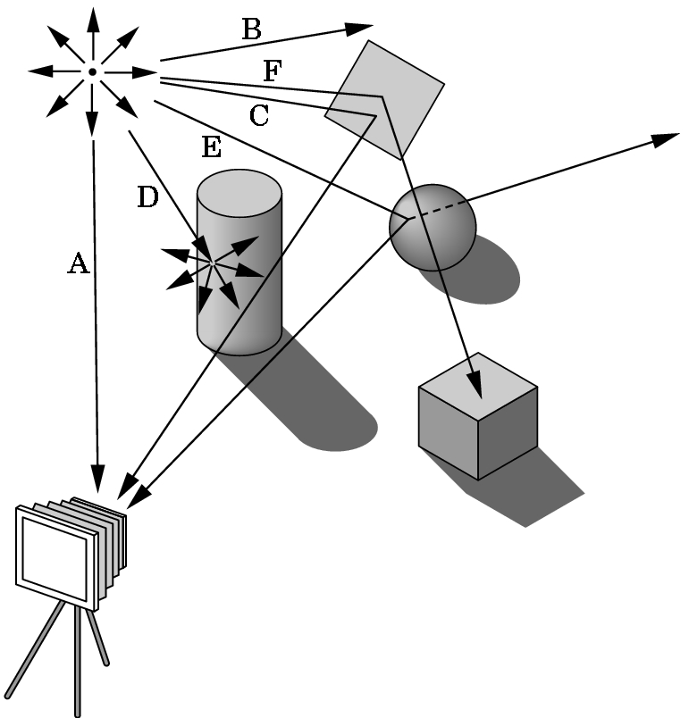
Ray Tracing and Geometric Optics
One way to form an image is to
follow rays of light from a
point source finding which
rays enter the lens of the
camera. However, each
ray of light may have
multiple interactions with objects
before being absorbed or going to infinity.

Slide 11
Luminance and Color Images
Luminance Image
Monochromatic
Values are gray levels
Analogous to working with black and white film or television
Color Image
Has perceptional attributes of hue, saturation, and lightness
Do we have to match every frequency in visible spectrum? No!

Slide 12
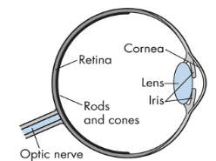
Three-Color Theory
Human visual system has two types of sensors
Rods: monochromatic, night vision
Cones
Color sensitive
Three types of cones
Only three values (the tristimulus
values) are sent to the brain
Need only match these three values
Need only three primary colors

Slide 13
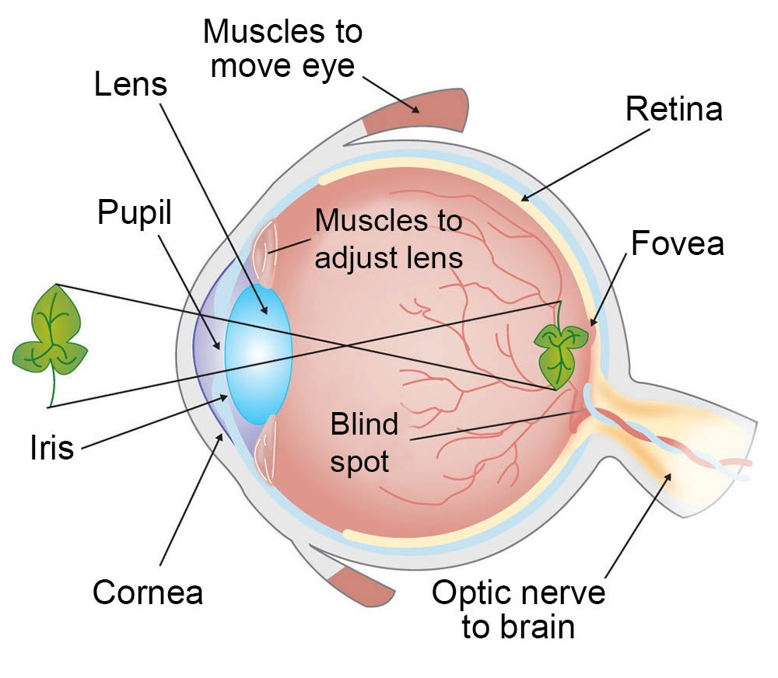
Three-Color Theory

Slide 14
Three-Color Theory
Rods work at very low levels of light. We use these for night vision because only a few bits of light (photons) can activate a rod. Rods don't help with color vision, which is why at night, we see everything in a gray scale. The human eye has over 100 million rod cells.
Cones require a lot more light and they are used to see color. We have three types of cones: blue, green, and red. The human eye only has about 6 million cones. Many of these are packed into the fovea, a small pit in the back of the eye that helps with the sharpness or detail of images

Slide 15
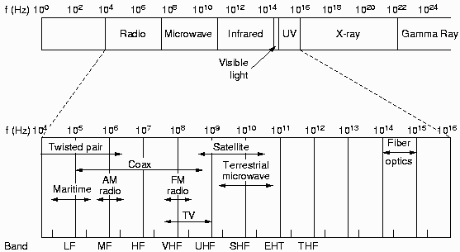
Colors
Colors
A narrow frequency band within the electromagnetic spectrum

Slide 16
Colors
Visible band
Each frequency corresponds to a distinct color
Low-frequency end (4.3 x 10¹⁴ Hz): Red
High-frequency end (7.5 x 10¹⁴ Hz): Violet
Wavelength λ = v/f, where v=300,000km/sec
Low frequency High frequency
red orange yellow green blue violet
Long wavelength Short wavelength
700nm 400nm

Slide 17
Colors
Colors of an object
Light source emits “white light” (all frequencies of light)
Object reflects/absorbs some frequencies
Color = combination of frequencies reflected
Dominant wavelength (or frequency)
Hue or color of the light
E.g., pink
S(λ): spectrum (luminance/intensity of light)
λ
400
620
700

Slide 18
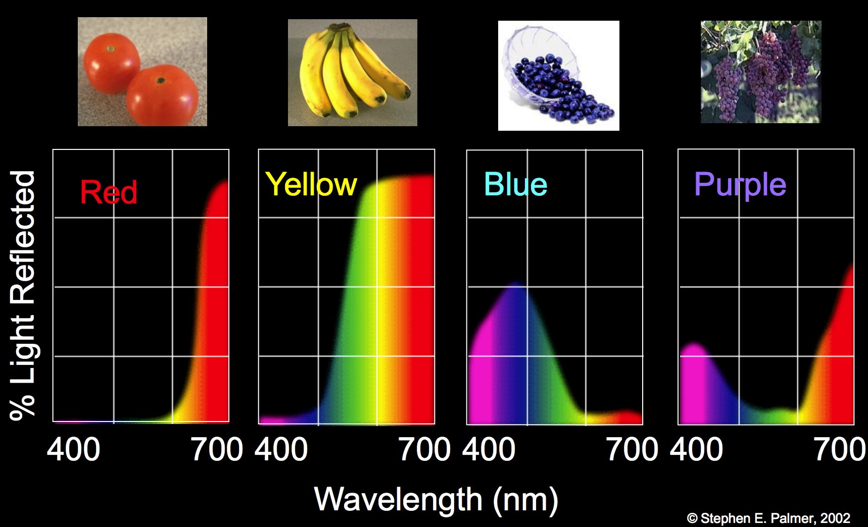
Objects reflect only some light

Slide 19
CIE Color Model
Color models
Use three primary colors to produce other colors
Primary colors
Colors used in a color model to produce all the other colors in that model.
Cannot be made from the other (two) colors defining the model.
CIE color model
X, Y, and Z: nonexistent, super saturated colors
Vectors in 3-D additive color space
Any color S = AX + BY + CZ

Slide 20
CIE Color Model
S = AX + BY + CZ can be normalized to
x = A/(A+B+C)
y = B/(A+B+C)
z = C/(A+B+C)
➔ s = xX + yY + zZ, where x + y + z = 1
➔ s lies in the plane x + y + z = 1 in 3D
y
λ=670
x
λ=400
z

Slide 21
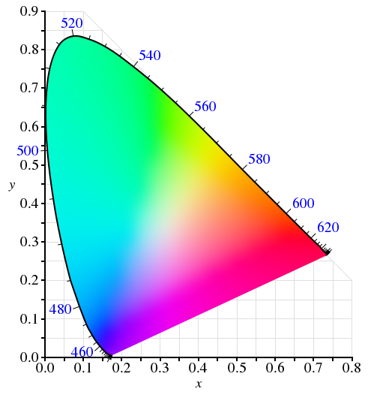
We can make a map of color
y
λ=670
x
λ=400
z

Slide 22
Linear colorspace
Pick some primaries
Can mix those primaries to match any color inside the triangle
There is a commision that studies color!
Commission internationale de l’éclairage (CIE) is a 100 year old organization that creates international standards related to light and color.

Slide 23
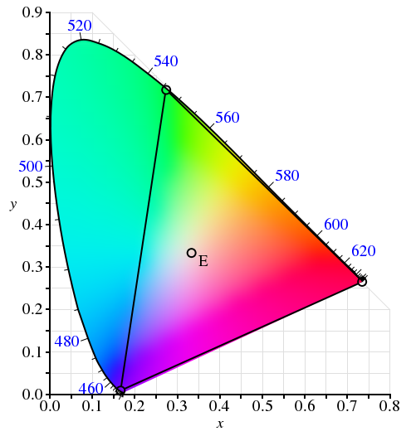
“Theoretical” CIE RGB primaries

Slide 24
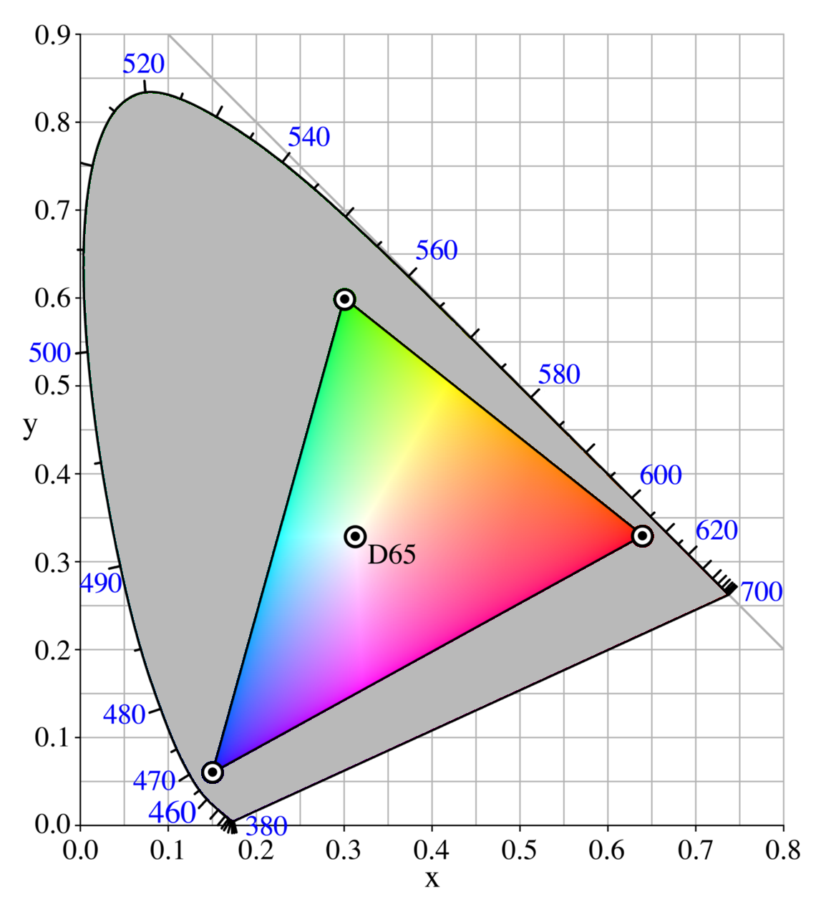
Practical sRGB primaries, MSFT 1996
sRGB (standard Red Green Blue) is an RGB color space that HP and Microsoft created
cooperatively in 1996 to use on monitors, printers, and the Internet. It was subsequently
standardized by the IEC (International Electrotechnical Commission) as IEC 61966-2-1:1999.

Slide 25
What does this mean for computers?
We represent images as grids of pixels
Each pixel has a color, 3 components: RGB
Not every color can be represented in RGB!
Have to go out in the real world sometimes
RGB is not fully accurate
We can represent a color with 3 numbers
#ff00ff; (1.0, 0.0, 1.0); 255,0,255
WHAT COLOR IS THAT?

Slide 26
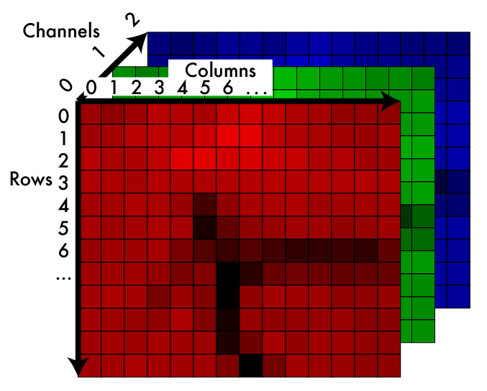
Image: 2d array of color
Some range
[0,255]
0.0 - 1.0

Slide 27
Grayscale - making color images not
We can simulate monochromatic images from RGB
Want a good approximation of how “bright” the image is without color information
(R+B+G/3) - looks weird
We should
Gamma decompress
Calculatight lightness
Gamma compress
We can just operate on sRGB
Typically ~ .30R + .59G + .11B

Slide 28
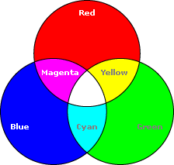
RGB Color Model

Slide 29
RGB Color Model
Color Cube
R + G = (1, 0, 0) + (0, 1, 0) = (1, 1, 0) = Y
R + B = (1, 0, 0) + (0, 0, 1) = (1, 0, 1) = M
B + G = (0, 0, 1) + (0, 1, 0) = (0, 1, 1) = C
R + G + B = (1, 1, 1) = W
1 – W = (0, 0, 0) = BLK
Grays = (x, x, x), where x ∈ (0, 1)

Slide 30
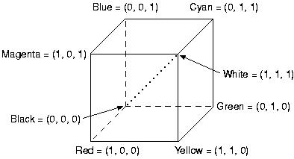
Color Cube

Slide 31
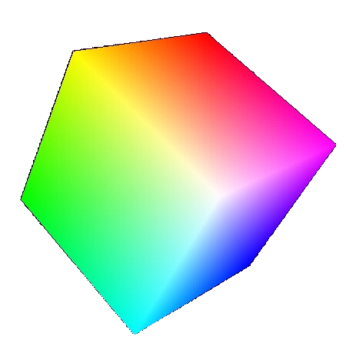
RGB
Additive model
Intensity of the three components
(0, 0, 1) Blue
(0, 1, 1) Cyan
(1, 0, 1)
Magenta
(1, 1, 1)
White
(0, 0, 0)
Black
(0, 1, 0) Green
(1, 1, 0) Yellow
(1, 0, 0) Red

Slide 32
CMY Color Model
CMY: Complements of RGB
Used in light absorbing devices
Hardcopy output devices
Subtractive
Color specified by what is subtracted from white light
Cyan absorbs red, magenta absorbs green, and yellow absorbs blue

Slide 33
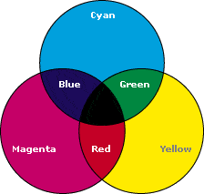
CMY Color Model

Slide 34
CMY Color Model
W = (0, 0, 0) B = (1, 1, 1)
Conversion from RGB to CMY
Conversion from CMY to RGB

Slide 35
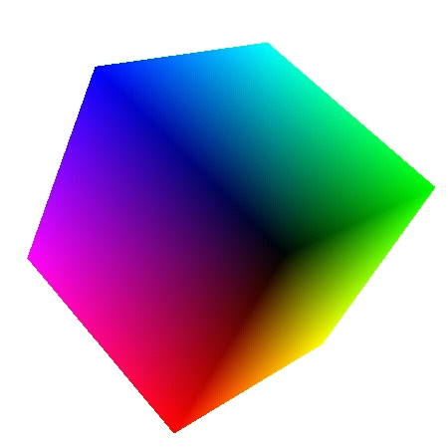
CMY
Subtractive model
(0, 0, 1) Yellow
(0, 1, 1) Red
(1, 0, 1)
Green
(1, 1, 1)
Black
(0, 0, 0)
White
(0, 1, 0) Magenta
(1, 1, 0) Blue
(1, 0, 0) Cyan

Slide 36
CMYK Color Model
Motivations
Do we get black if paint cyan, magenta and yellow on a white paper?
Which cartridge is more expensive?
CMYK model
K = greatest gray that can be extracted
Given C, M, and Y
K = min(C, M, Y)
C = C – K
M = M – K
Y = Y – K
Try some examples…

Slide 37
YIQ Color Model
Used in U.S. commercial color-TV broadcasting
Recoding of RGB for transmission efficiency
Backward compatible with black-and-white TV
Transmitted using NTSC (National Television System Committee) standard

Slide 38
YIQ Color Model
YIQ
Y: luminance
I, Q: chromaticity
Only Y shown in black-and-white TV
RGB → YIQ

Slide 39
YIQ Color Model
Human’s visual properties
More sensitive to changes in luminance than in hue or saturation
➔ more bits should be used to represent Y than I and Q
Limited color sensation to objects covering extremely small part of our field of view
➔ One, rather than two color dimensions would be adequate
➔ I or Q can have a lower bandwidth than the others

Slide 40
YIQ Color Model
NTSC encoding of YIQ into broadcast signal
Uses human’s visual system properties to maximize information transmitted in a fixed bandwidth
Y: 4MHz
I: 1.5MHz
Q: 0.6MHz

Slide 41
Specifying Color
Color perception usually involves three quantities:
Hue: Distinguishes between colors like red, green, blue, etc
Saturation: How far the color is from a gray of equal intensity
Lightness: The perceived intensity of a reflecting object
Sometimes lightness is called brightness if the object is emitting light instead of reflecting it.
In order to use color precisely in computer graphics, we need to be able to specify and measure colors.

Slide 42
Intuitive Color Concepts
Terminology
Perceptual Term | Colorimetry | Comments
hue | dominated wavelength | to distinguish colors
saturation | excitation purity | e.g., red and pink
Lightness (reflecting objects) | luminance
Brightness (self-luminous objects) | luminance | e.g., Sun, CRT

Slide 43
How Do Artists Do It?
Artists often specify color as tints, shades, and tones of saturated (pure) pigments
Tint: Gotten by adding white to a pure pigment, decreasing saturation
Shade: Gotten by adding black to a pure pigment, decreasing lightness
Tone: Gotten by adding white and black to a pure pigment
White
Tints
Grays
Tones
Pure Color
Shades
Black

Slide 44
Intuitive Color Concepts
Tints, shades, and tones ➔ different colors of same hue are produced
Grays
= black pigments + white pigments
Graphics packages that provide color palettes to users often employ two or more color models

Slide 45
HSV Color Space
Computer scientists frequently use an intuitive color space that corresponds to tint, shade, and tone:
Hue - The color we see (red, green, purple)
Saturation - How far is the color from gray (pink is less saturated than red, sky blue is less saturated than royal blue)
Brightness (Luminance) - How bright is the color (how bright are the lights illuminating the object?)

Slide 46
HSV Color Model
HSV = Hue, Saturation, and Value
A.k.a. HSB, where B is Brightness
Cylinder coordinate system
Space: hexcone
hexagon is obtained from the color cube in isometric projection
(h, s, v), where h ∈ [0, 360) and s, v ∈ [0, 1]

Slide 47

Hue, Saturation, Value
Different model based on perception of light
Hue: what color
Saturation: how much color
Value: how bright
Allows easy image transforms
Shift the hue
Increase saturation

Slide 48
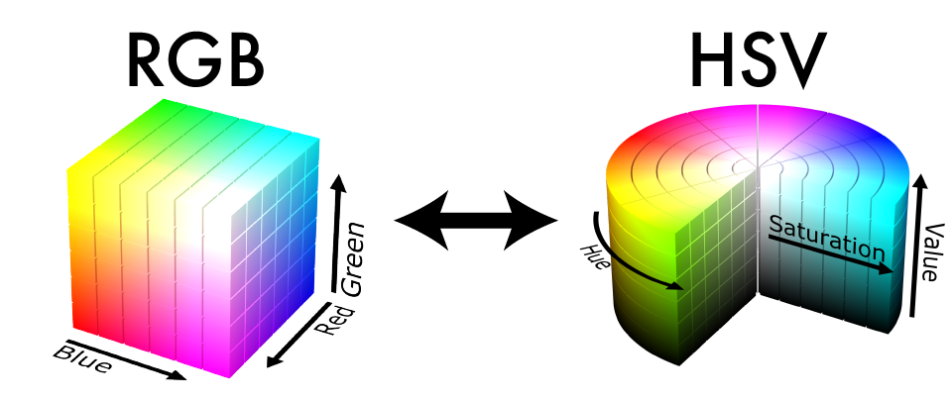
Other colorspaces are fun!

Slide 49
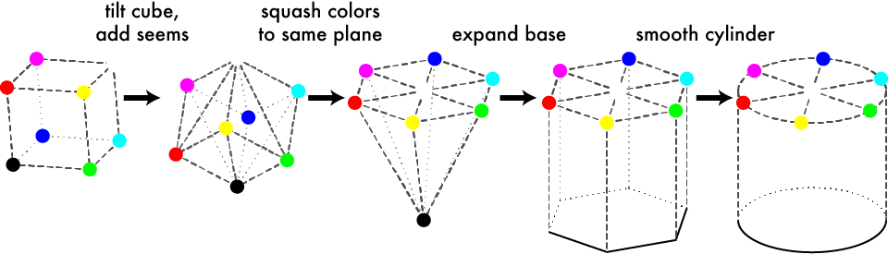
Geometric HSV to RGB:

Slide 50
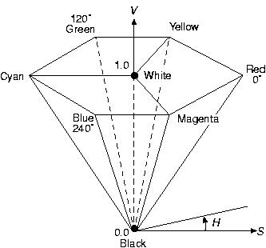
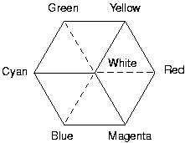
HSV Color Model
Color Cube Hexcone

Slide 51
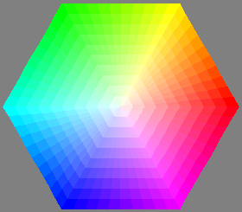
Intuitive Color Spaces
A top-down view of hexcone

Slide 52
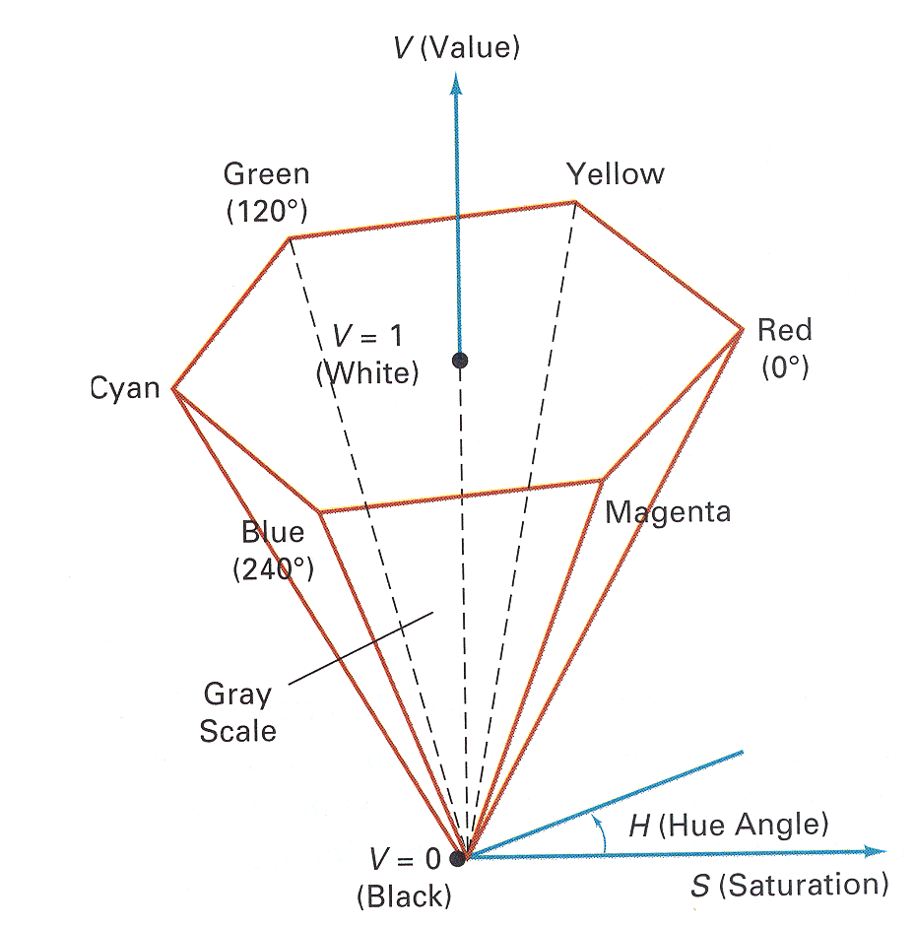
HSV Color Model
Hue (H) is the angle around the vertical axis
Saturation (S) is a value from 0 to 1 indicating how far from the vertical axis the color lies
Value (V) is the height of the hexcone”

Slide 53
HSV Color Model
W = (-, 0, 1)
B = (-, 0, 0)
R = (0, 1, 1)
Y = (60, 1, 1)
:
M = (300, 1, 1)
Adding white pigments ⇔ S↓
Adding black pigments ⇔ V↓
Creating tones ⇔ S↓ and V↓

Slide 54
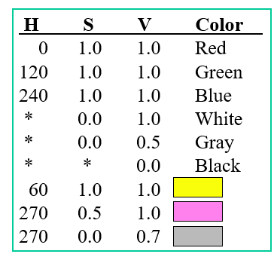
HSV Color Model
Figure 15.16&15.17 from H&B

Slide 55
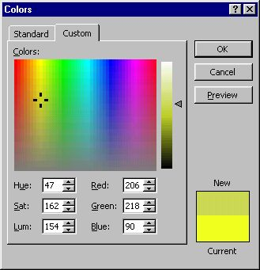
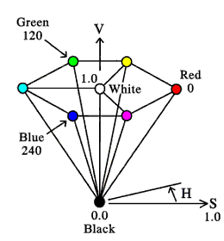
HSV Color Space
A more intuitive color space
H = Hue
S = Saturation
V = Value (or brightness)
Saturation
Value
Hue

Slide 56
HSV Color Model
True color system: 16 million colors
Q: Do we need that many?
Human eyes can distinguish
128 hues
130 tints (saturation levels)
23 shades of yellow colors, 16 of blue colors
➔ 128 x 130 x 23 = 82720 colors

Slide 57
Hue, Saturation, Value: cylinder!

Slide 58
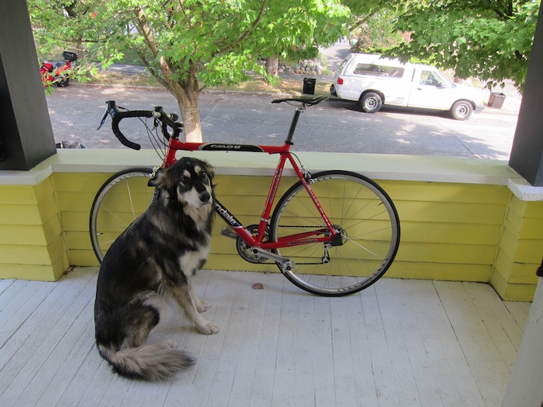
An RGB Image

Slide 59
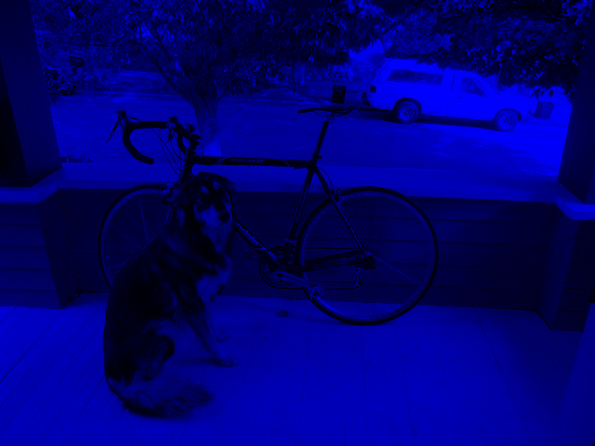
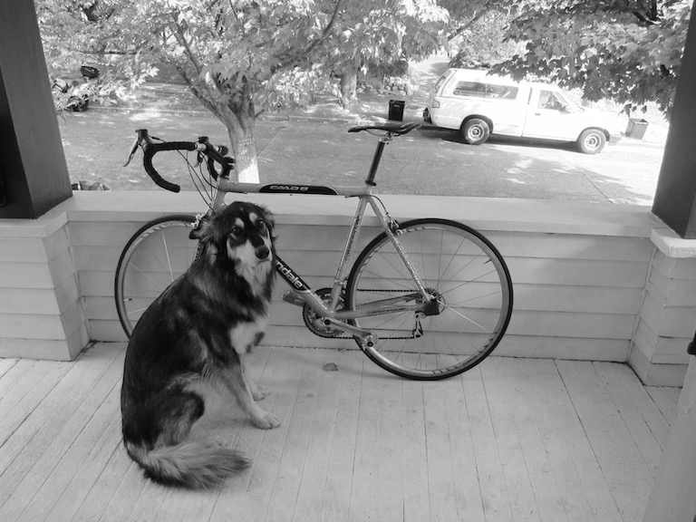
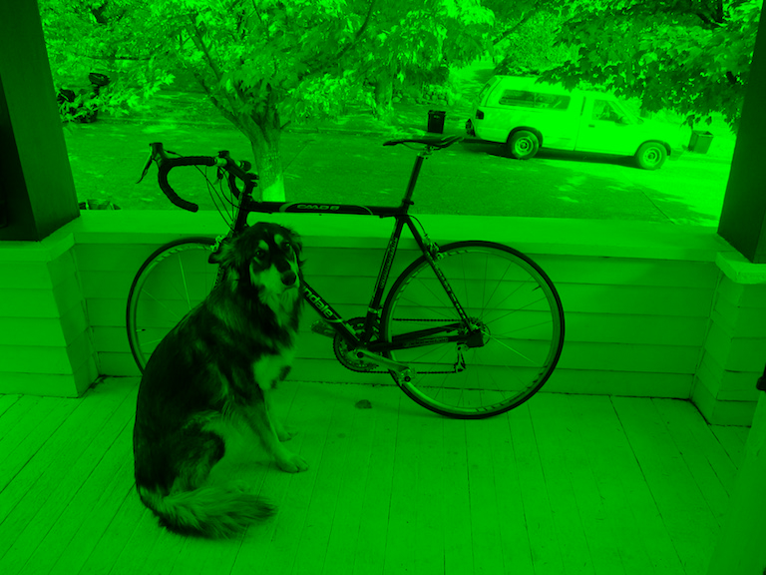
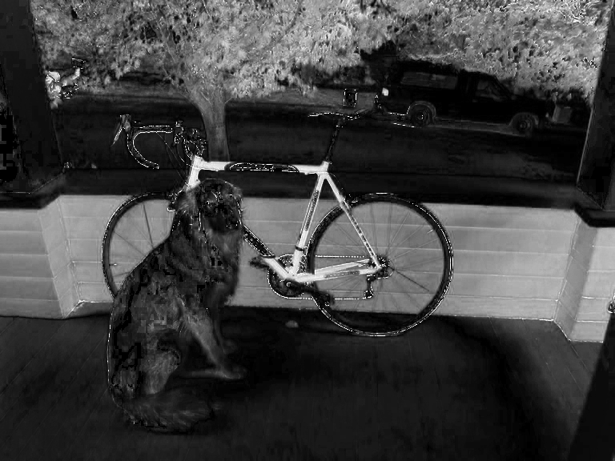
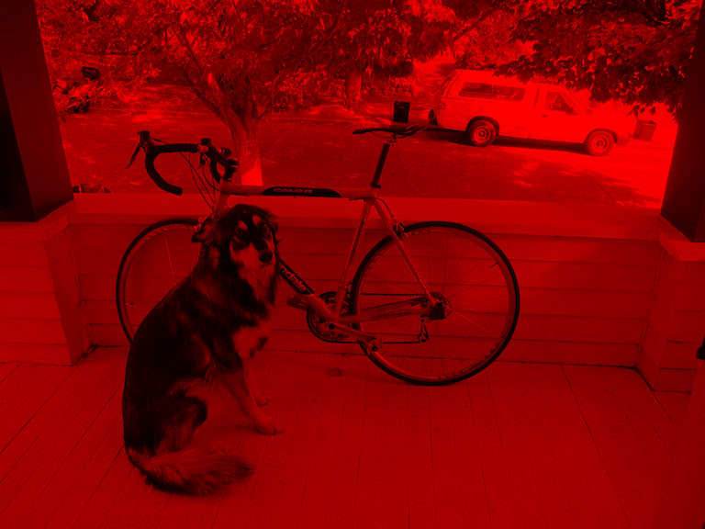
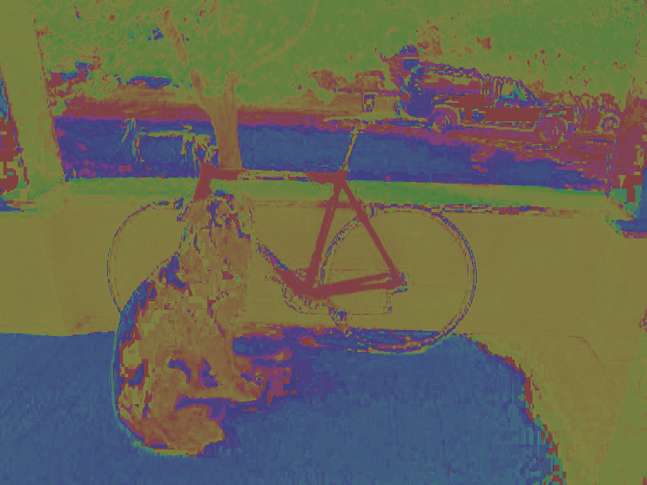
Still 3d tensor, different info

Slide 60
Hue Saturation Value

Slide 61
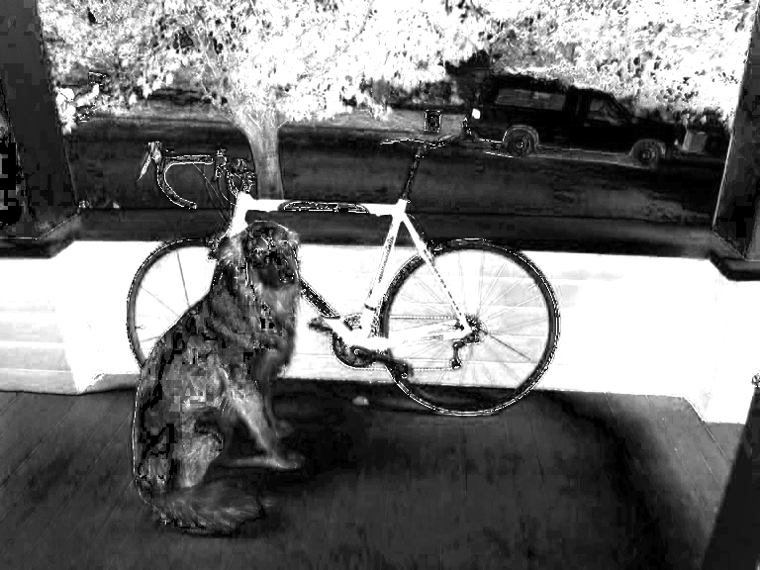
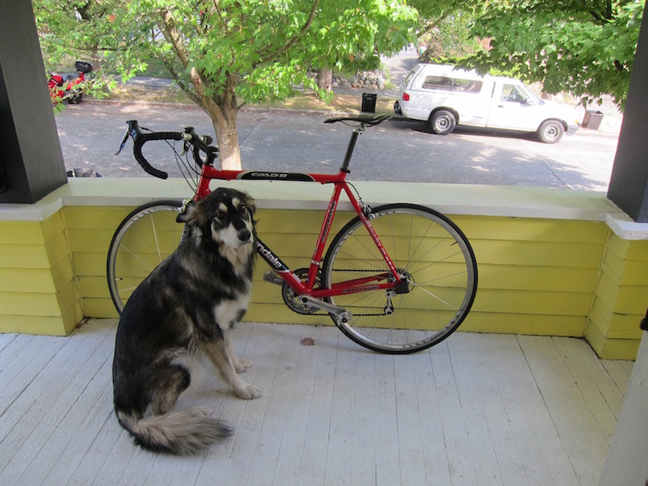
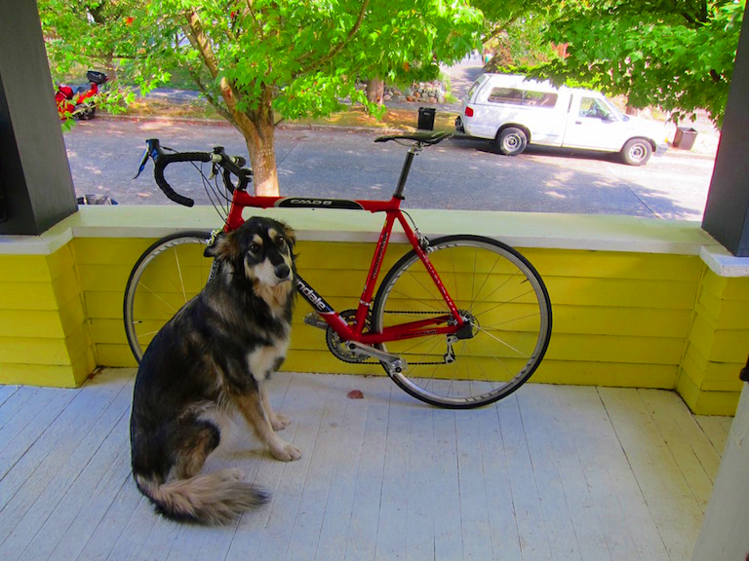
More saturation = intense colors
H Channel S Channel V Channel
2x

Slide 62
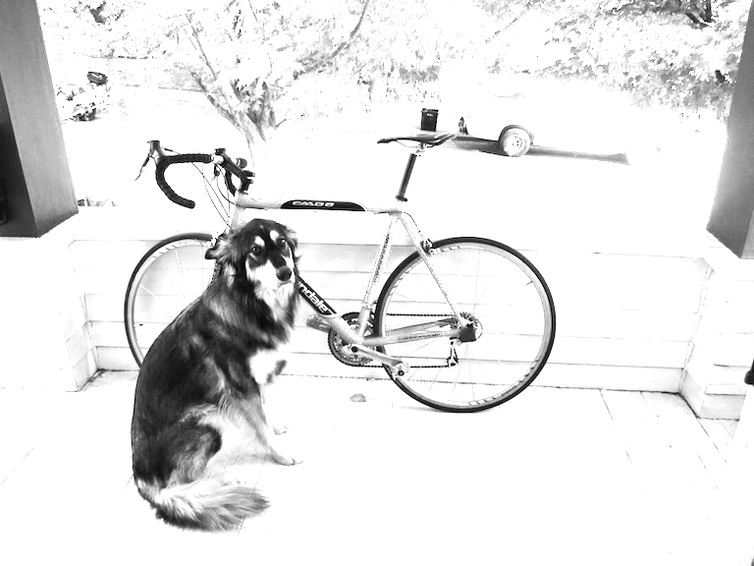
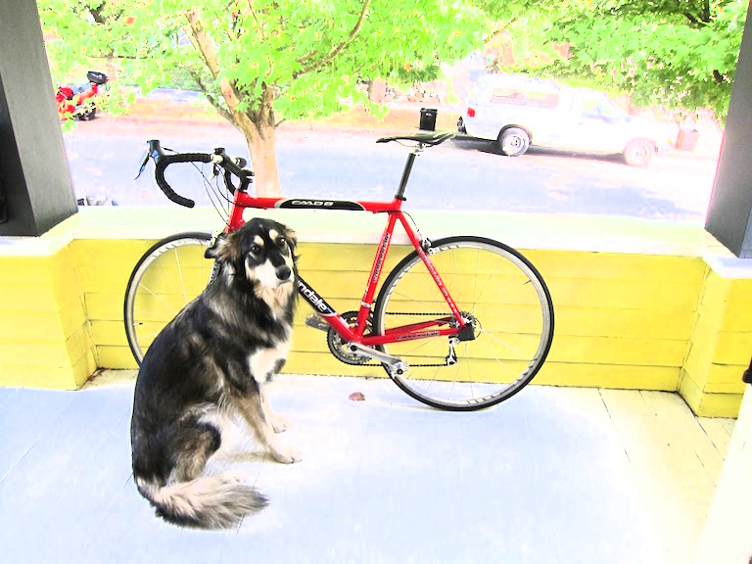
More value = lighter image
H Channel S Channel V Channel
2x

Slide 63
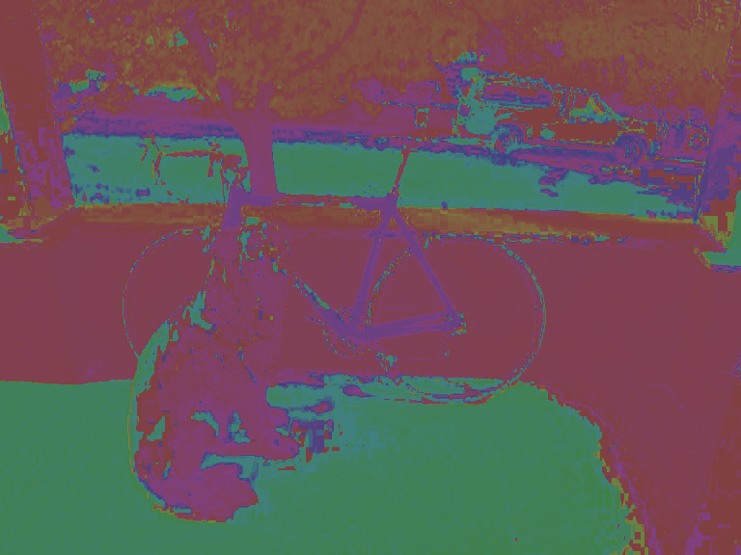
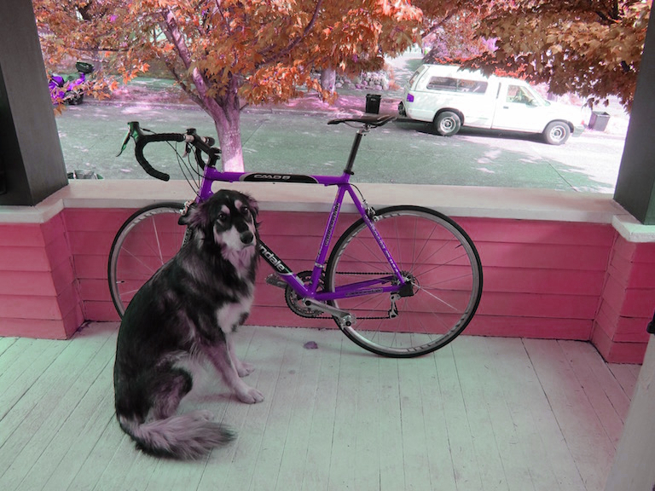
Shift hue = shift colors
H Channel S Channel V Channel
-.2

Slide 64

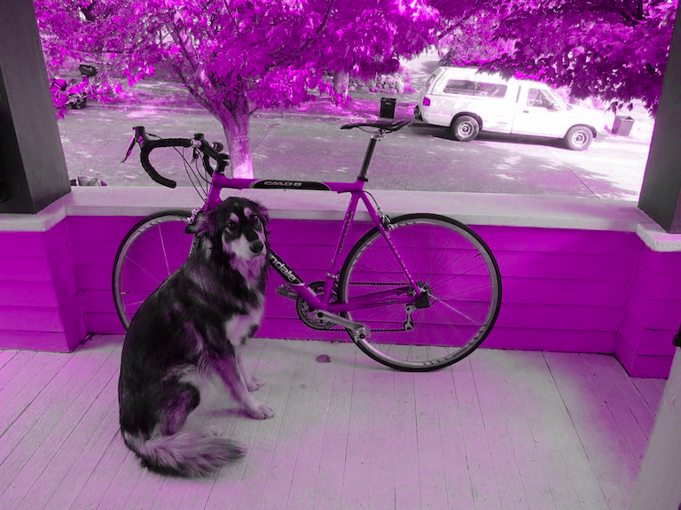
Set hue to your favorite color!
H Channel S Channel V Channel

Slide 65
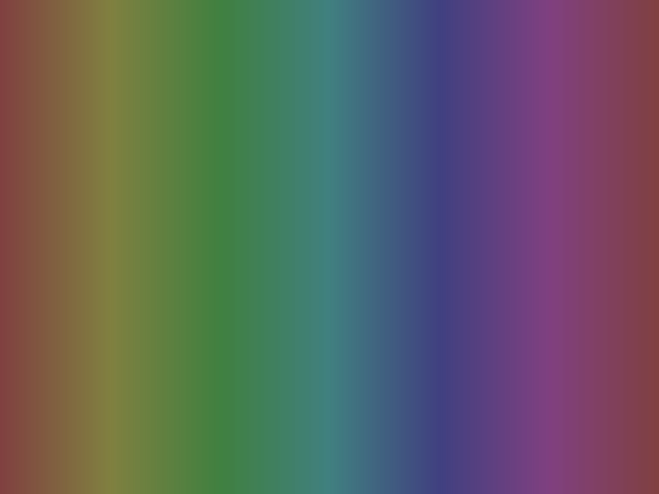
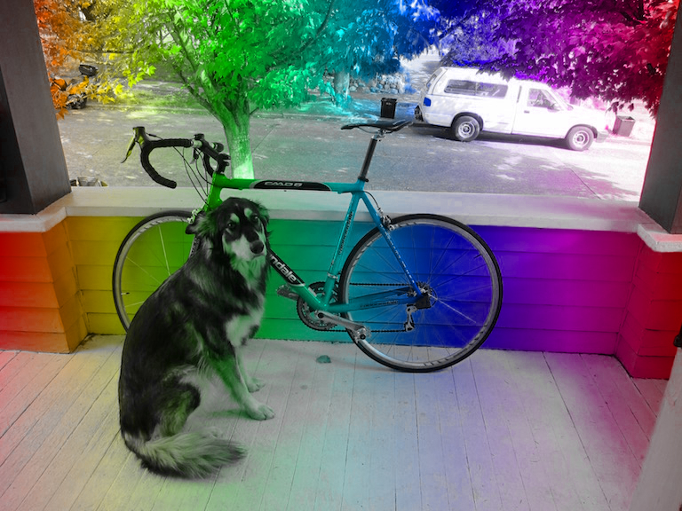
Or pattern...
H Channel S Channel V Channel

Slide 66
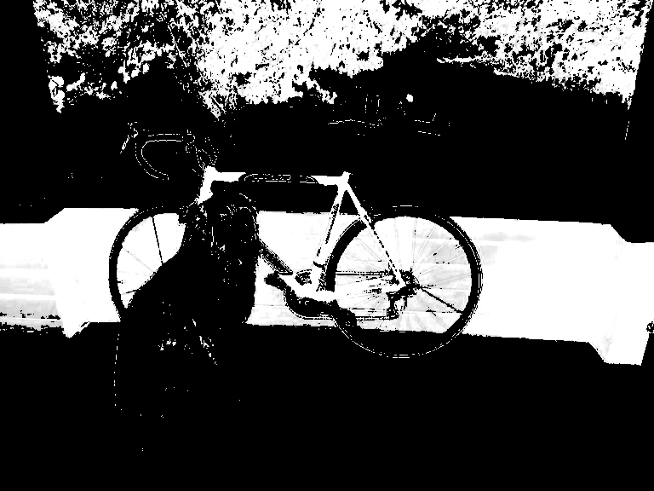
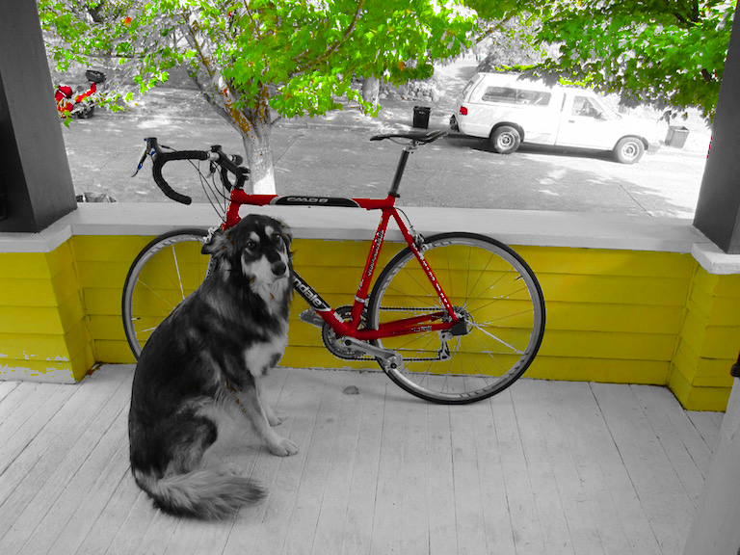
Increase and threshold saturation
H Channel S Channel V Channel

Slide 68
More Details on Color Spaces
RGB
HSI/HSV
CIE L*a*b
YIQ
Opponent
standard for cameras
allows us to separate
intensity plus 2 color channels
color TVs, Y is intensity
used in Swain & Ballard work

Slide 69
RGB Color Space
Absolute Normalized
Normalized red r = R/(R+G+B)
Normalized green g = G/(R+G+B)
Normalized blue b = B/(R+G+B)
(0,0,255)
blue
R,G,B)
(0,0,0)
(0,255,0)
red
green
(255,0,0)

Slide 70
Color hexagon for HSI (HSV)
Hue is encoded as an angle (0 to 2π).
Saturation is the distance to the vertical axis (0 to 1).
Intensity is the height along the vertical axis (0 to 1).
H=120 is green
saturation
intensity
hue
H=180 is cyan
I=1
H=0 is red
H=240 is blue
I=0

Slide 71
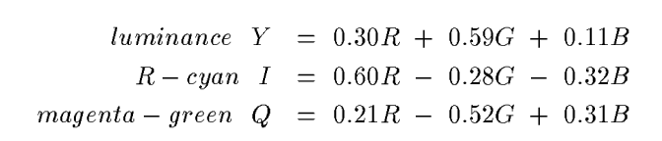
Conversion from RGB to YIQ
An approximate linear transformation from RGB to YIQ:
We often use this for color to gray-tone conversion.

Slide 72
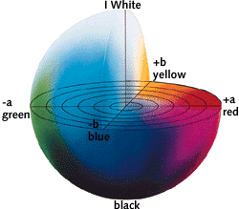
CIELAB, Lab, L*a*b
One luminance channel (L)
and two color channels (a and b).
In this model, the color differences which you perceive correspond to Euclidian distances in CIELab.
The a axis extends from green (-a) to red (+a) and the b axis from blue (-b) to yellow (+b). The brightness (L) increases from the bottom to the top of the three-dimensional model.
CIE L*a*b* (CIELAB) is a color space specified by the International Commission on
Illumination (French Commission internationale de l'éclairage, hence its CIE initialism).

Slide 73
Histograms
A histogram of a gray-tone image is an array H[*] of bins, one for each gray tone.
H[i] gives the count of how many pixels of an image have gray tone i.
P[i] (the normalized histogram) gives the percentage of pixels that have gray tone i.

Slide 74
Color histograms can represent an image
Histogram is fast and easy to compute.
Size can easily be normalized so that different image histograms can be compared.
Can match color histograms for database query or classification.

Slide 75
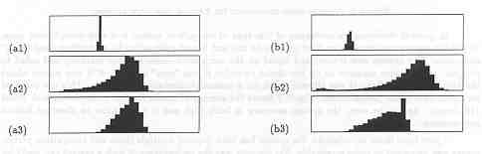
Apples versus Oranges
H
S
I
Separate HSI histograms for apples (left) and oranges (right) used by IBM’s VeggieVision for recognizing produce at the grocery store checkout station (see Ch 16).

Slide 76
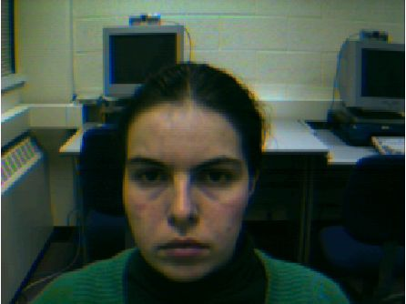
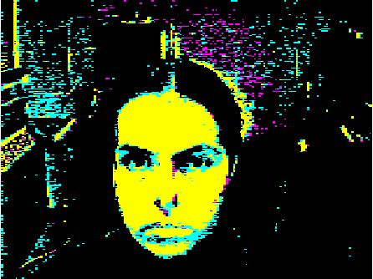
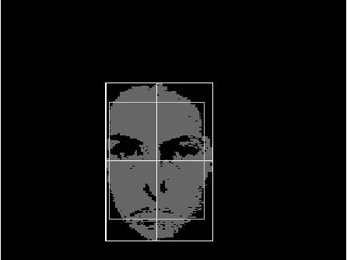
Finding a face in video frame
(left) input video frame
(center) pixels classified according to RGB space
(right) largest connected component with aspect similar to a face (all work contributed by Vera Bakic)

